Slide 1
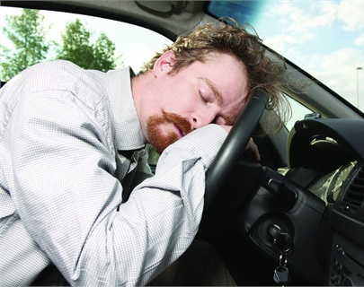
Comparative study for Drowsiness detection using Deep learning techniques
Contributors:
Ashwanthika Umasankar (1001854976)
Devendhar Mandala (1001916600)
Anusha Vobbilireddy. (1001926298)
This Photo by Unknown Author is licensed under CC BY-SA

Slide 2
INTRODUCTION
Increased demand for mobility has necessitated faster transportation growth in recent years. The automobile is now an essential way of commuting for most people. Although automobile has altered people's lifestyles and made routine activities more convenient, it is also connected to a range of negative consequences, such as road accidents.
As we know, sleeping while driving is very dangerous not only for the driver, but also for others.
Numerous accident cases have been reported due to the driver falling asleep while driving for maybe even a second.
The most disturbing issue is that drowsy driving isn't merely falling asleep behind the wheel. When a driver is not paying full attention to the road, drowsy driving can be as simple as a momentary state of unconsciousness.
Our approach to this issue is to create a detection system that identifies the key aspects of drowsiness and send out an alert before it's too late, utilizing image detection/recognition and CNN algorithms.

Slide 3
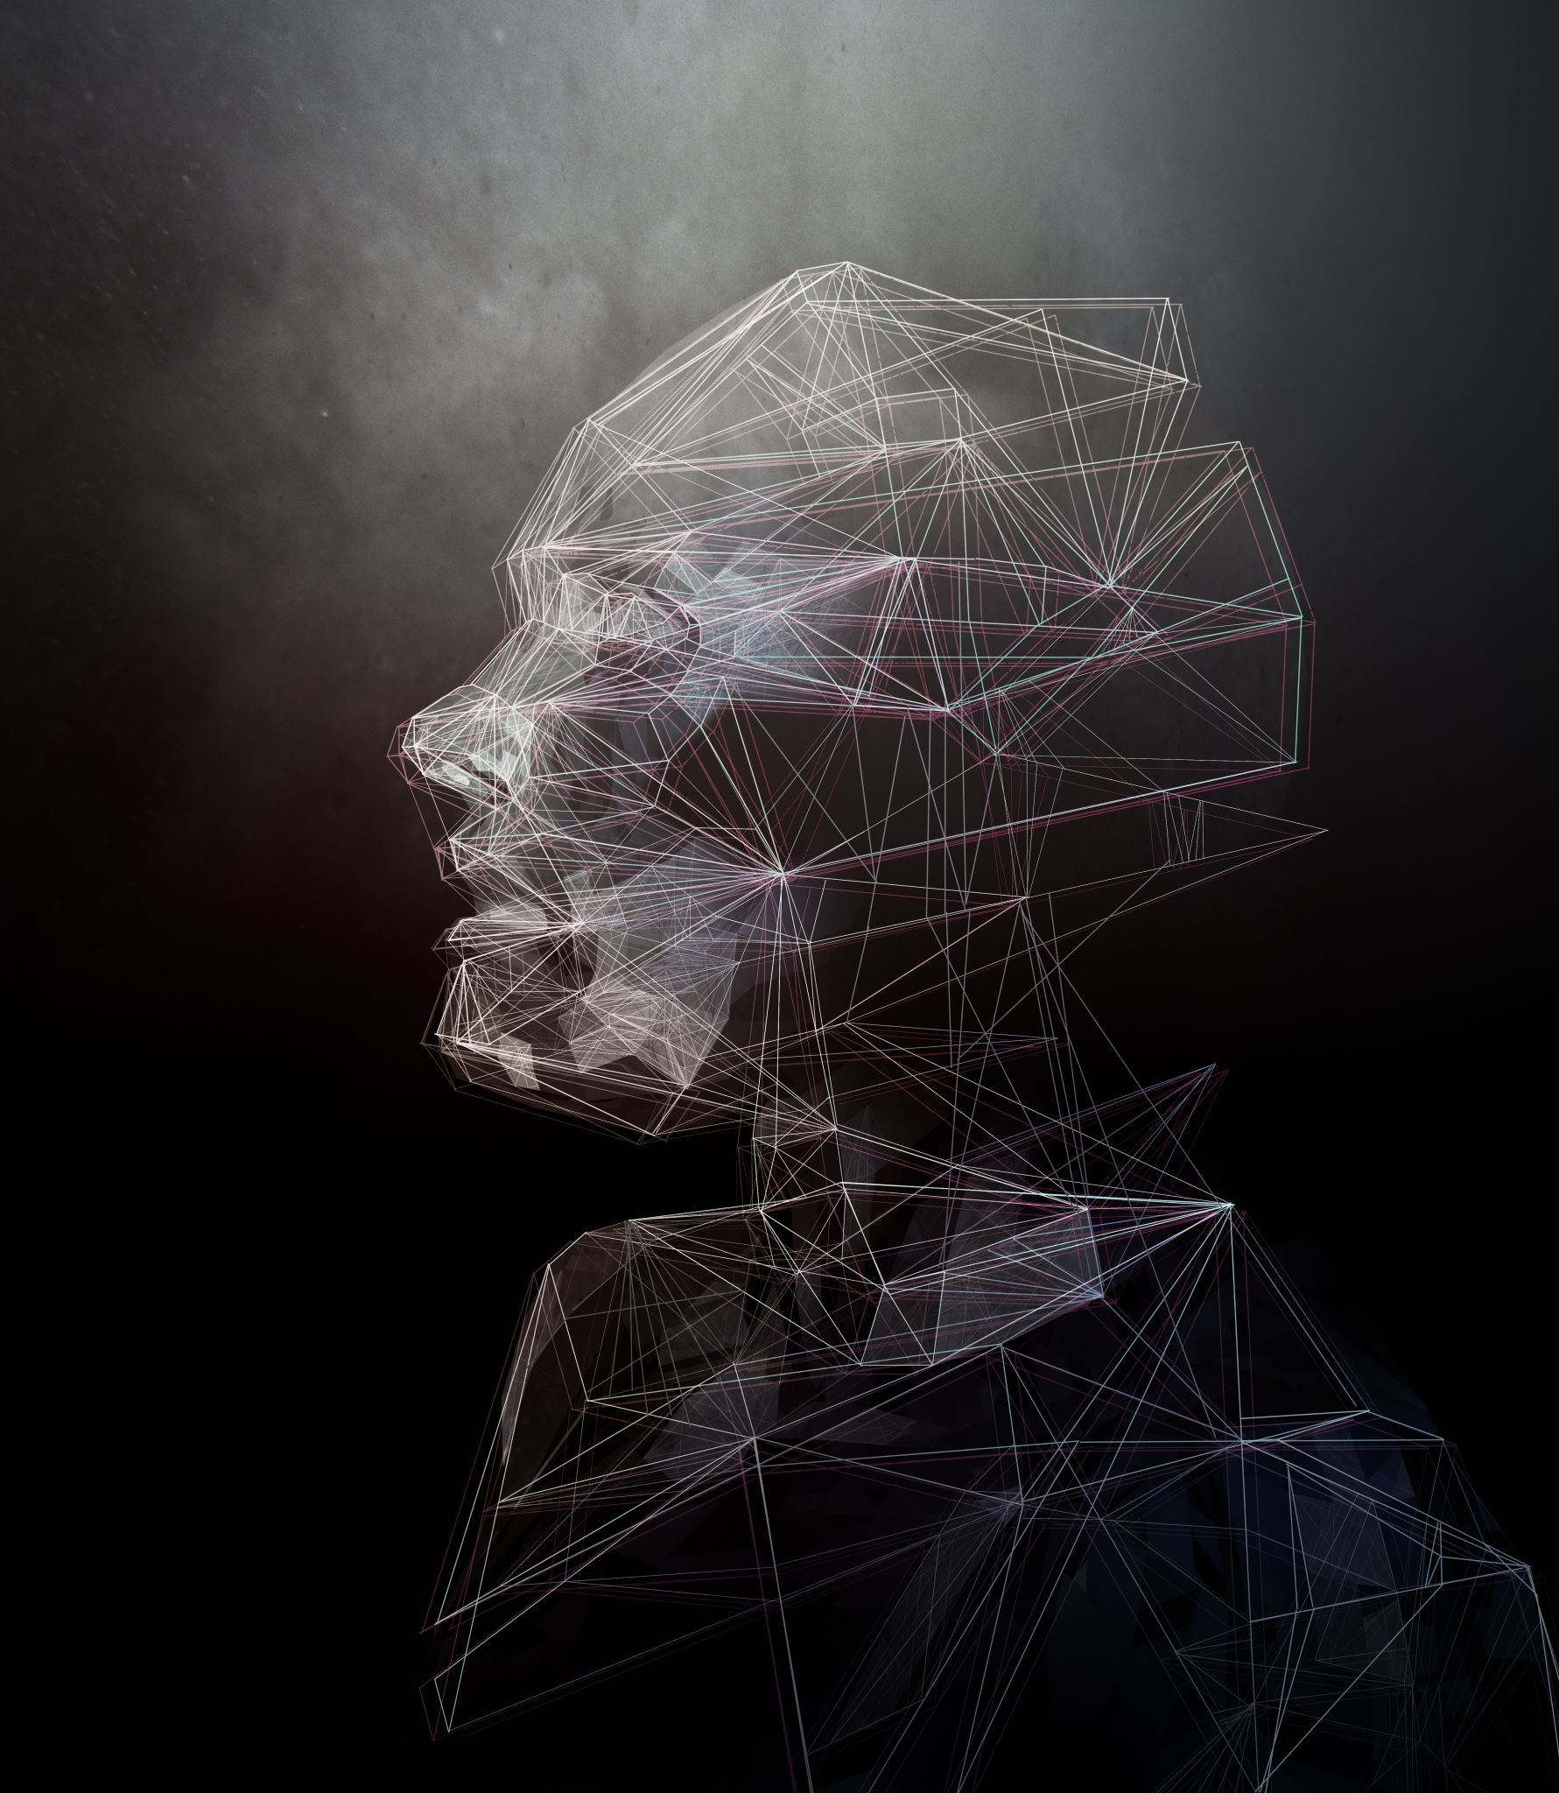
Dataset
We have taken the dataset from Kaggle.
We are considering the movement of eyes, whether a person’s eyes are open or closed.
The dataset contains images of drowsiness-related data.
The images are categorized into Open Eyes, Closed Eyes.

Slide 4
Project Flow
We have implemented our project using:
1. CNN model using np arrays.
2. CNN model using keras.
3. VGG 16 model using keras.
Project contains 5 ipynb files:
1. CNN file using np arrays from scratch
2. CNN model using keras
2a. CNN code for training data.
2b. CNN code for the testing data
3. VGG 16 model
3a. VGG16 code code for training data
3b. VGG16 code code for testing data

Slide 5
What is CNN?
Convolutional neural networks are a specialized type of artificial neural networks that use a mathematical operation called convolution in place of general matrix multiplication in at least one of their layers.
They are specifically designed to process pixel data and are used in image recognition and processing.
Layers of CNN are Convolution, Pooling, Fully connected layers. It also include Non-Linearity layers like sigmoid, Tanh, RelU.

Slide 6


Slide 7
Model
Preprocessing
With the help of ImageDataGenerators:
We resized the image to 256*256 .
Converted the image into gray scale. We do this because CNN will accept only gray scale images.
As part of data augmentation, we use the horizontal flip.
Image transformation also done by zooming the images.

Slide 8
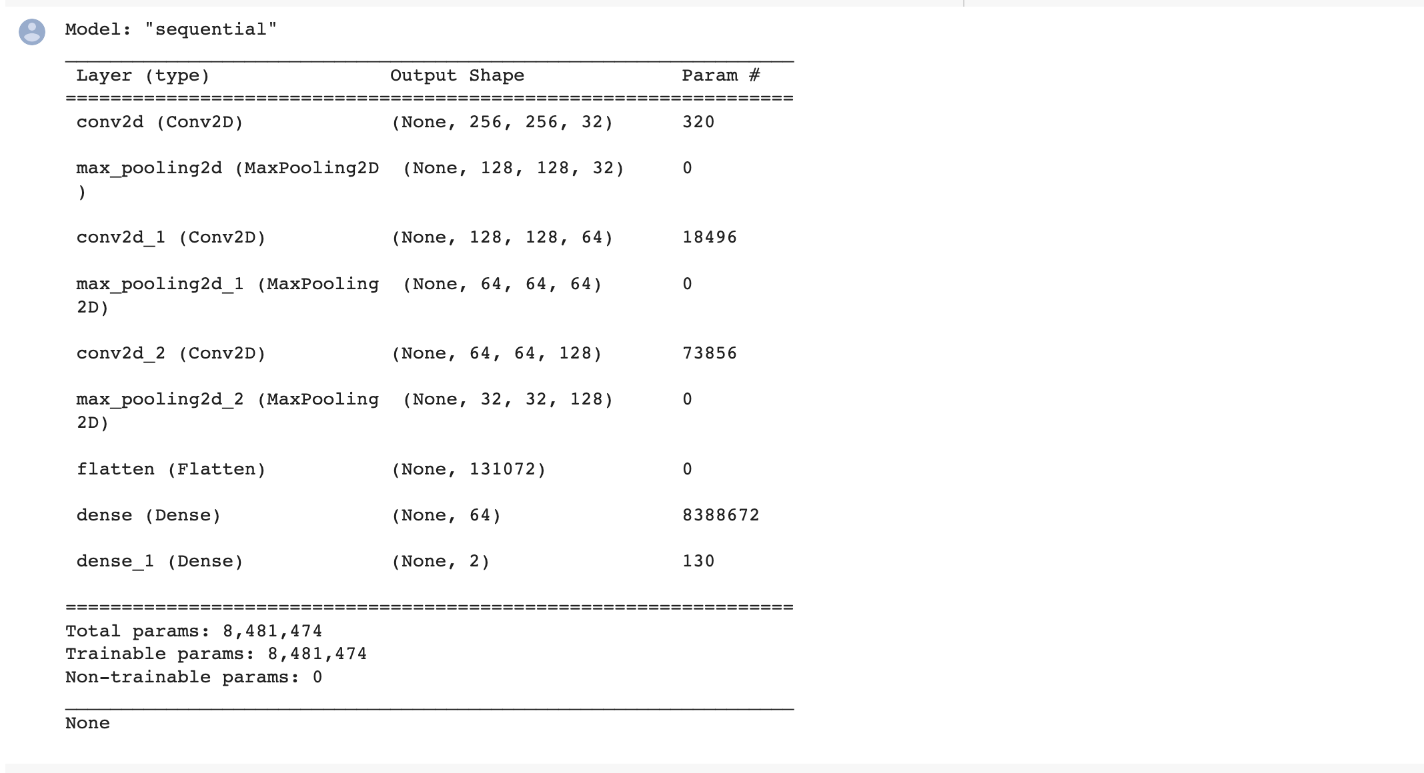
Implementation
Our CNN model built with keras contains an input layer, two hidden layers, one fully connected layer and output layer.

Slide 9
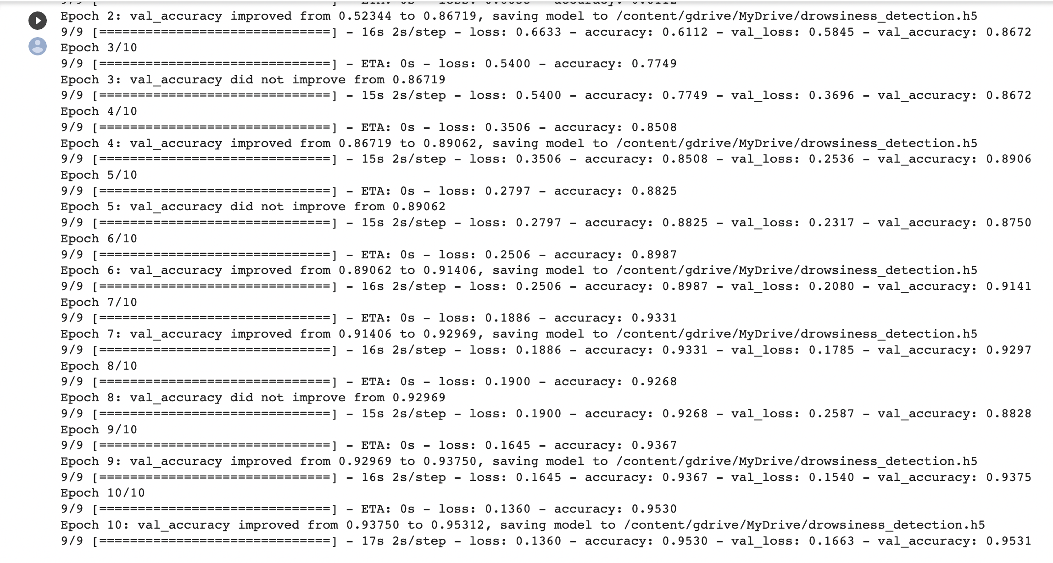
Model Performance
In basic CNN using keras we using:
To compile the model we use the parameters like adam optimizers, categorical cross entropy. To judge the performance of the model we used the accuracy metric.

Slide 10
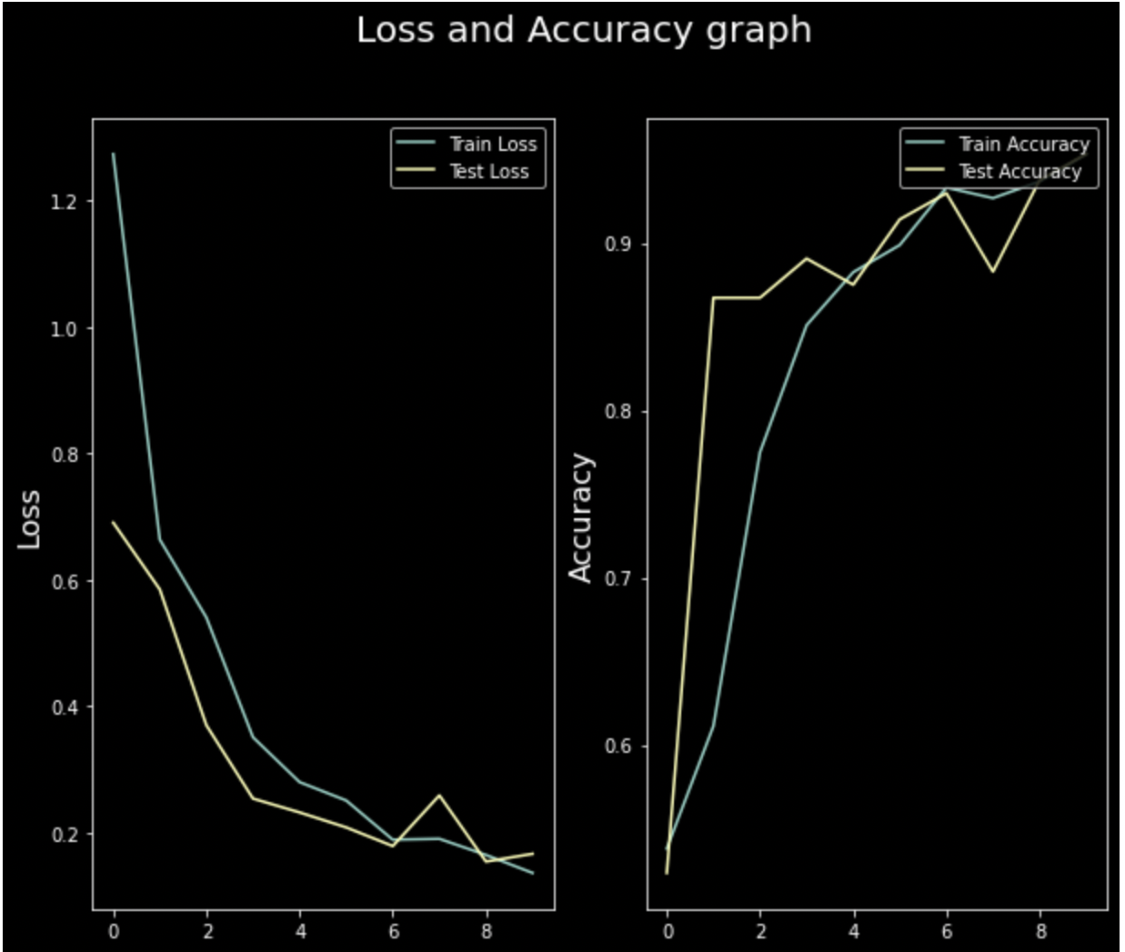

Slide 11
What is VGG16?
VGG-16 is a convolutional neural network that is 16 layers deep. You can load a pretrained version of the network trained on more than a million images from the database . The pretrained network can classify images into 1000 object categories, such as keyboard, mouse, pencil, and many animals.
VGG16 is composed of 13 convolutional layers, 5 max-pooling layers, and 3 fully connected layers. Therefore, the number of layers having tunable parameters is 16 (13 convolutional layers and 3 fully connected layers). That is the reason why the model name is VGG16.

Slide 12
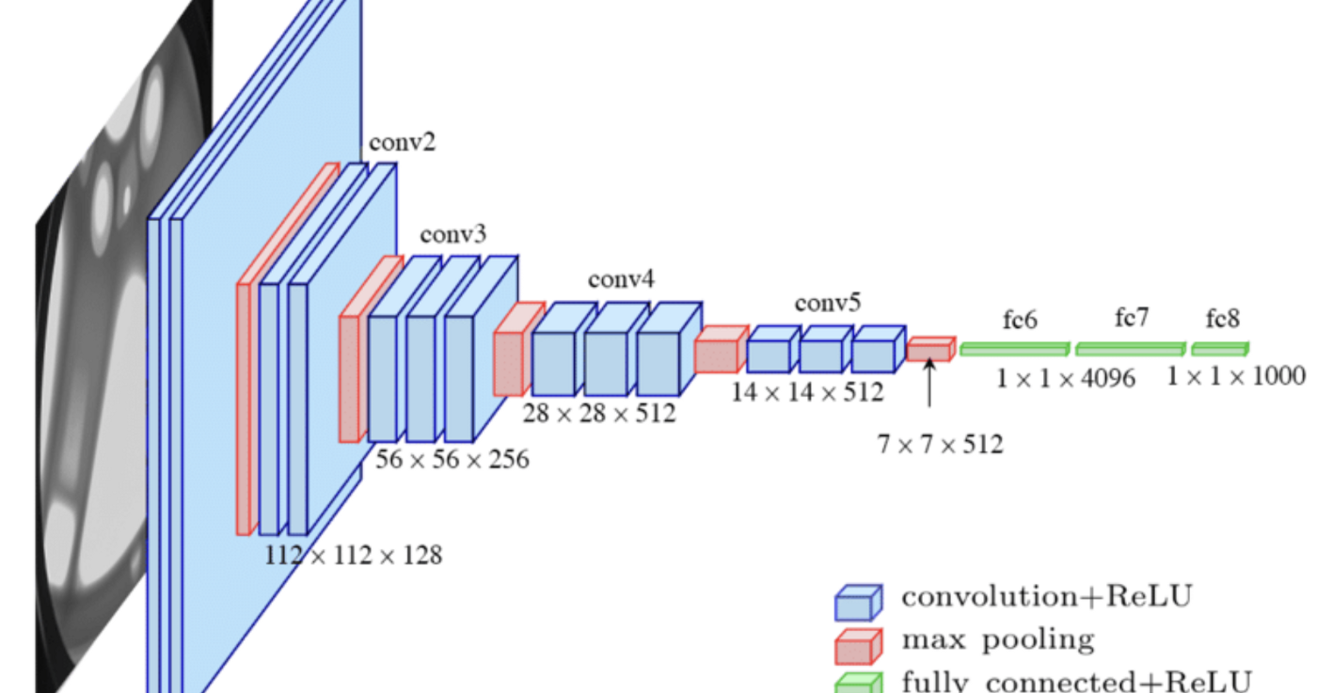

Slide 13
Model VGG16
Preprocessing
With the help of ImageDataGenerators:
We resize the image to 224*224 .
As part of data augmentation, we use the horizontal_flip.
Image transformation also done by zooming the images as well applying shear transformations to the images.

Slide 14
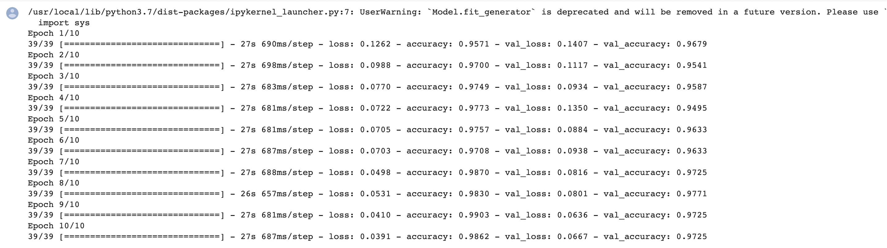
Implementation

Slide 15
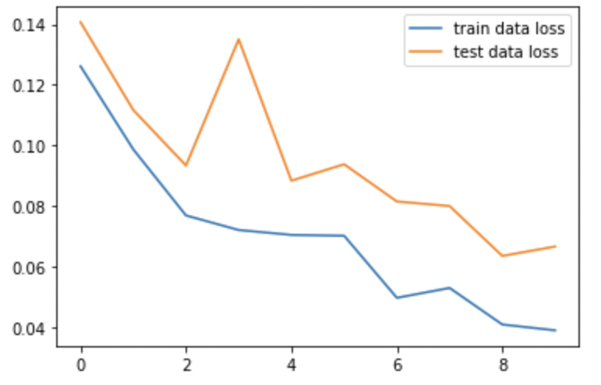
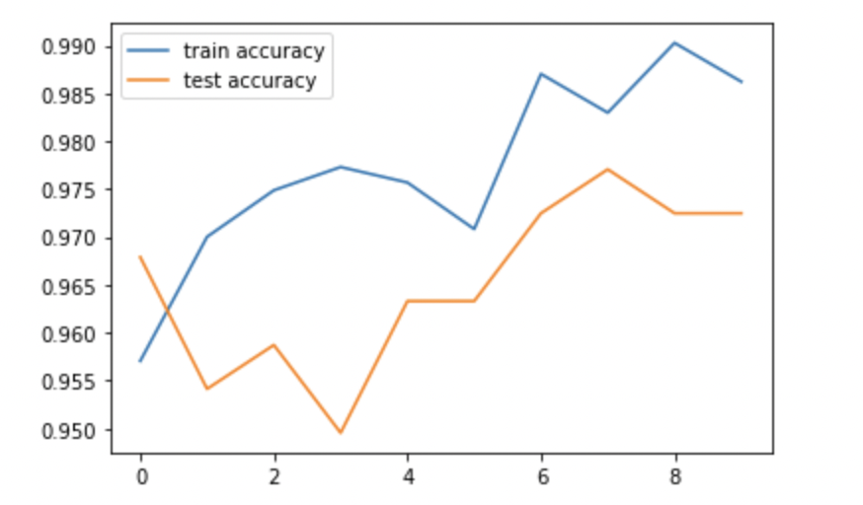
Model Performance and accuracy

Slide 16
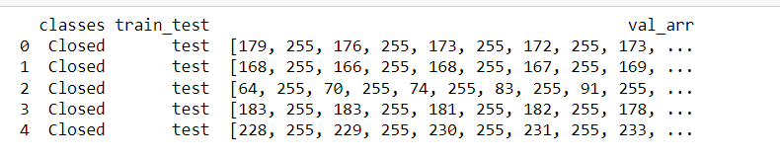

Basic CNN from Scratch
Preprocessing
we are converting an image to gray scale then resizing image to 48*48
we are converting all the images to a dictionary format which contains image pixel array, its actions i.e., closed/open eye and repository train/test

Slide 17
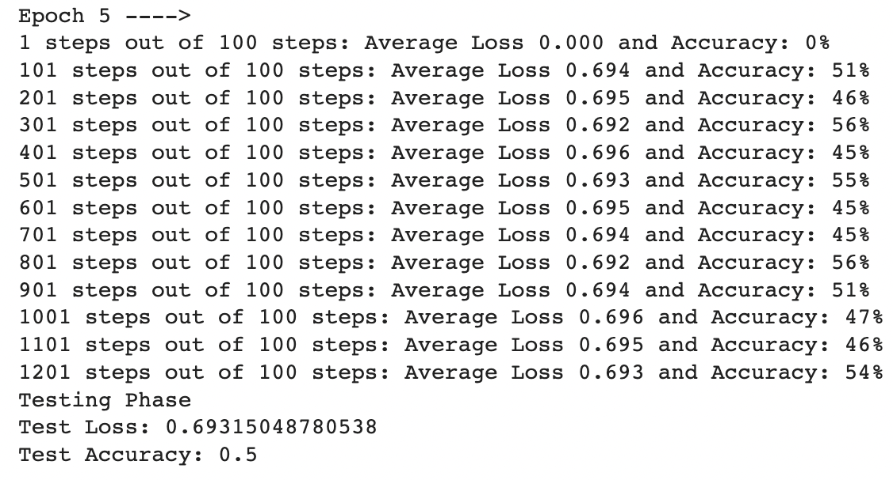
Implementation
We created one convolution layer.
One maxpooling layer.
One activation function(Softmax).
We are running model for 5 epochs.

Slide 18
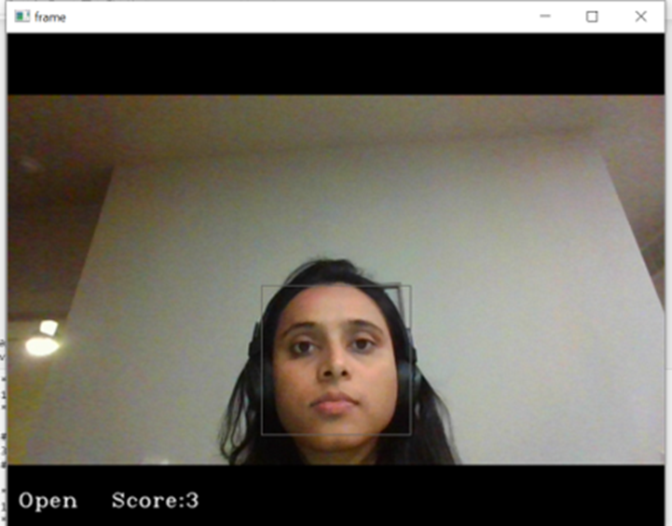
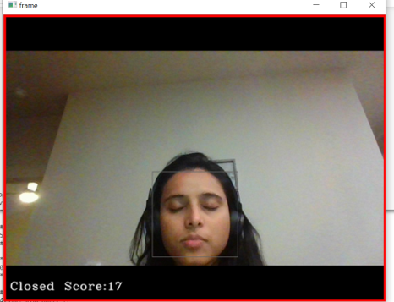
Test Results
Results for CNN and VGG16 using keras:
Once the training of the model is complete, we can go ahead with testing. For testing the model, we import the saved train model into the test file. We have used haarcascade for image identification in our test model. Haarcascade helps us in identifying facial features and extracting them. We use it to identify the eyes from a person’s face. Upon executing the test file, a video recorder opens that checks whether the persons eyes are open/ close and it computes a score. If the person’s eyes are closed for a count >=16 it concludes that the persons eyes are closed indicating that the driver has fallen asleep and it rings an alarm and captures a picture.

Slide 19
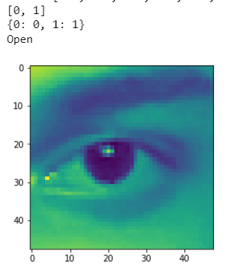
Results for CNN using NumPy:
Our test file predicts whether the given test image is open or closed.

Slide 20
Conclusion
 | Train accuracy | Test accuracy | Loss Accuracy
CNN _Keras | 95.3 | 95.0 | 13.6
VGG16 | 98.62 | 97.25 | 03.91
CNN_NumPy | 54 | 50 | 69.3
Above stats says that vgg16 model gives high accuracy because it’s a Transfer Learning Model

Slide 21
Future improvements
1.In CNN using NumPy we can try to improve the accuracy by adding more convolution layers , pooling layers and activation functions that will help to improve the model performance and accuracy.
2. CNN using NumPy model that will work in realtime like our keras model
3. We can also integrate all the models into a working environment and see which gives the best performance.

